Slide 1
Tizen Unified & Configurable: Configure & Create Any IoT and Smart Devices On-The-Fly with Minimal Resources
MyungJoo Ham, Ph.D.
Samsung Electronics

Slide 2
DISCLAIMERS
This is about Tizen 4.0
Already deployed and working.
Welcomed to visit us at the booth, “Tizen Image Creator”
Meme from imgflip.com

Slide 3
The Old Tizen
Until Tizen 3.0

Slide 4

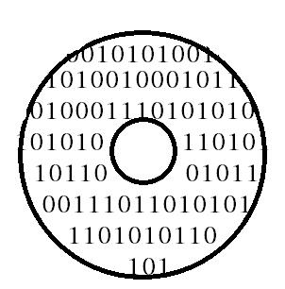



The Old Tizen: Profile = Build Project
Build option = mobile
Build option = TV
Build option = wearable
Build #profile times.
“deviced.rpm” from mobile is not compatible for wearable
Images from samsung.com

Slide 5
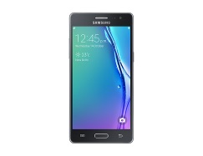

The Old Tizen: Profile x Device = Build Project
Build option = mobile
Build option = mobile-TM1
Build option = TV
Build option = TV-emulator
Build option = wearable
Actually, build #profile x #repository times.
A developer needs to build & test #p x #r times for each change.
Images from samsung.com

Slide 6
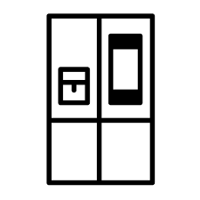





The Old Tizen: Profile x Device = Build Project
Build option = mobile
Build option = mobile-TM1
Hard to add a new device types / a new device
Almost Impossible to build them all for each change!
Extreme Workload on Build/Release Infrastructure!
Build option = TV
Build option = TV-emulator
Build option = wearable
……
Images from samsung.com

Slide 7

The Old Tizen: Promotes Bad Habits
Build option = mobile
Build option = mobile-TM1
#ifdef TIZEN_PROFILE_WEARABLE
int func_public()
{ ... } #endif
// Exported function!!!
……
enum blah_t {
_ANONYMIZED_EXAMPLE,
#ifdef TIZEN_PROFILE_TV
_N_TV, #endif
_N_32, // Is this 1? 2? #ifdef TIZEN_PROFILE_MOBILE
_N_24, #endif
}; // In an API header!!!
#ifdef TIZEN_MOBILE_TM1
call_func(); #endif
do_something();
// Middleware/Service layer!
Images from samsung.com, https://imgflip.com/memegenerator/Jackie-Chan-WTF

Slide 8
Objectives
What we wanted?

Slide 9








Objectives
A Single Package Repository
Build option = TIZEN
Build Once.
Use for All Device Types.
* Normally, a single git repo generates 2 ~ 3 RPM packages.

Slide 10
Objectives
A Single Package Repository
Build option = TIZEN
Build Once.
Use for All Device Types.
3. Configure Any Devices from a Single, Shared RPM Repository.
* Normally, a single git repo generates 2 ~ 3 RPM packages.

Slide 11
Objectives
A Single Package Repository
RPM packages
Build packages Compile option = TIZEN
Build Once.
Use for All Device Types.
3. Configure Any Devices from a Single, Shared RPM Repository.
* Normally, a single git repo generates 2 ~ 3 RPM packages.

Slide 12

Objectives
A Single Package Repository
RPM packages
2500 ARM32 RPM packages
Build packages Compile option = TIZEN
* Normally, a single git repo generates 2 ~ 3 RPM packages.
Image from https://thehobbyheaven.wordpress.com/2013/08/02/starting-the-lego-adventure/ https://imgflip.com/memegenerator/Jackie-Chan-WTF

Slide 13

Objectives
A Single Package Repository
4. Make it easier to configure.
Focus on products and features, not packages
* Normally, a single git repo generates 2 ~ 3 RPM packages.
Image from http://knowyourmeme.com/memes/yao-ming-face-bitch-please

Slide 14

What’s Done

Slide 15
What’s Done (1/4): Build Once
Build Once!
SINGLE Build Project
Tizen: Mobile (714 pkgs)
Tizen: Common (822 pkgs)
Tizen: IVI (740 pkgs)
Tizen: TV (609 pkgs)
Tizen: Wearable (598 pkgs)
Tizen: Unified (968 pkgs)
No hints for profile at build time.
The macro “profile” is now UNDEFINED.
Accomplished for Tizen 4.0 in 2017.4.
3,483 pkgs

Slide 16
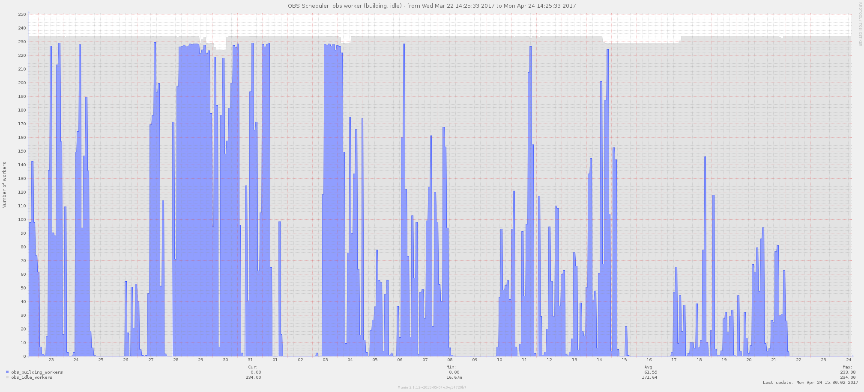
What’s Done (1/4): Build Once
Before
After
# Busy Workers (build servers)
* Tizen 3.0 projects are still building per profile x repository

Slide 17
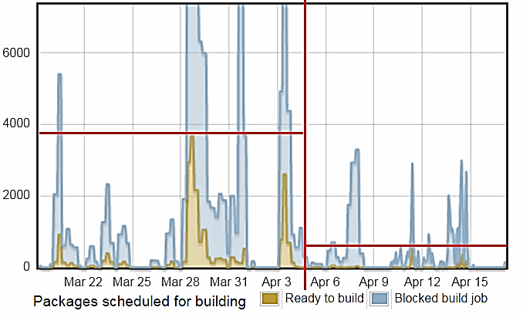
What’s Done (1/4): Build Once
Before
After
# Build Tasks in Queue
Yellow: “Ready”
Blue: “Blocked”
* Tizen 3.0 projects are still building per profile x repository

Slide 18
What’s Done (2/4): For All Devices
Build Once! ➔ Packages Shared by All Device Types
Created, Tested, and Verified
All Tizen official snapshot images are created from the unified repository.
Tested and verified.
http://download.tizen.org/snapshots/tizen/unified/
Creates all 33 device images from a single unified RPM repo.
* Emulator repository is being merged into Standard. (All related commits are merged.)

Slide 19
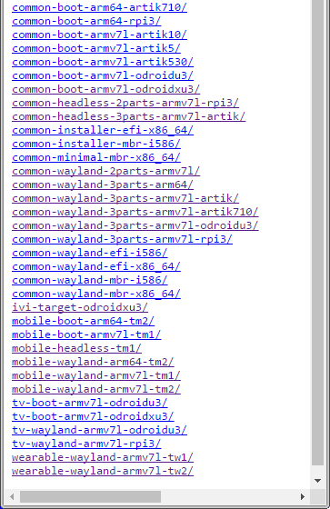
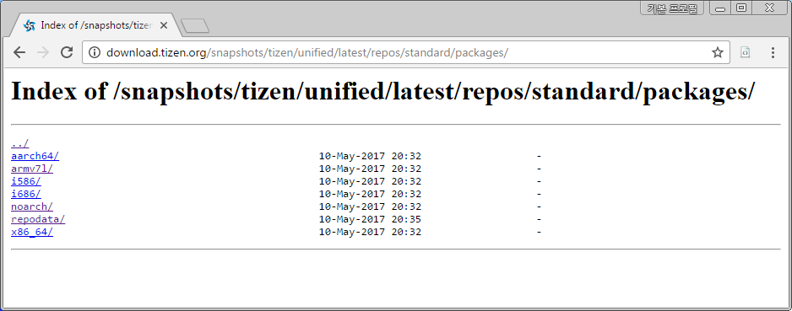
What’s Done (2/4): For All Devices
Build Once! ➔ Packages Shared by All Device Types

Slide 20
What’s Done (3/4): Configure
Build Once! ➔ Packages Shared by All Device Types ➔ Configure a New Device
All Tizen OS Images do not require any “profile” or “build projects”.
IoT and “Conventional” smart devices are being created from “Tizen:Unified”

Slide 21
What’s Done (4/4): Easy to Configure
Build Once! ➔ Packages Shared by All Device Types ➔ Configure a New Device ➔ Make it EASY!
Do NOT require to
select each RPM!
understand dependencies of Tizen packages
understand KS, MIC, YAML, RPM-spec, ...
➔ Tizen Image Creator

Slide 22
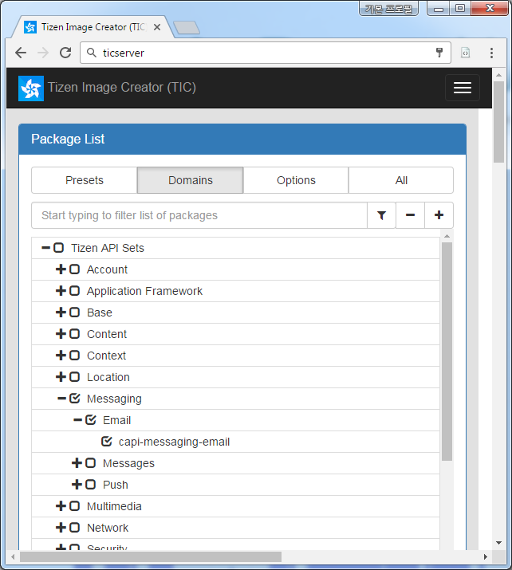
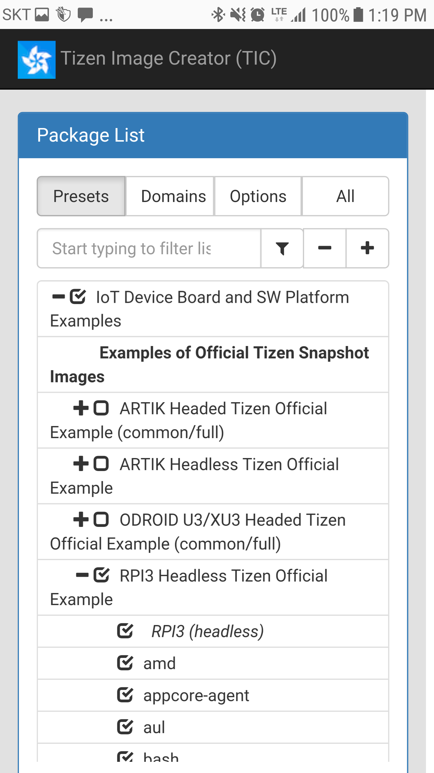
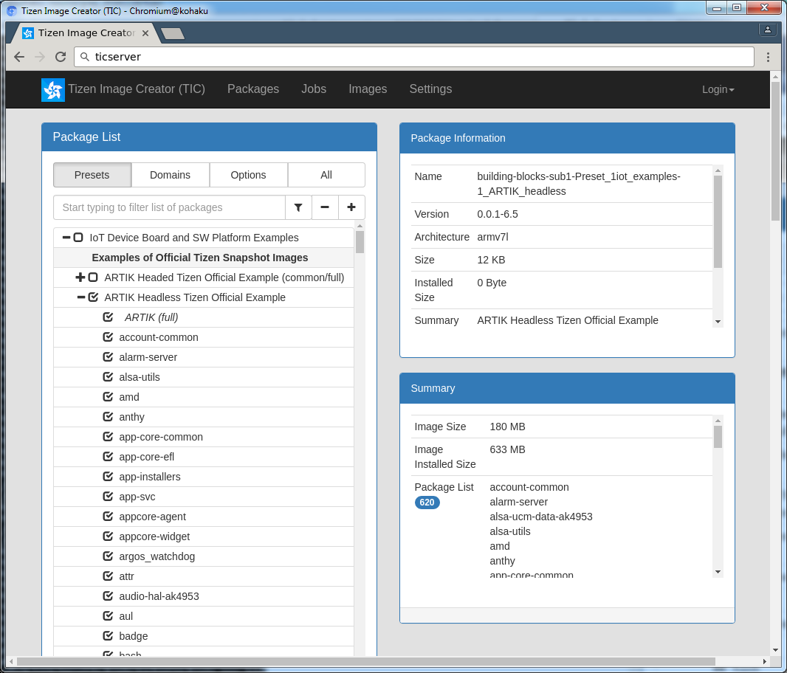


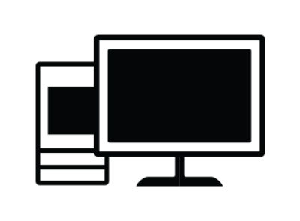
Tizen Image Creator (Visit Demo Booth!)

Slide 23

Tizen Image Creator (Visit Demo Booth!)
No need to build packages.
Prebuilt RPMs from download.tizen.org

Slide 24
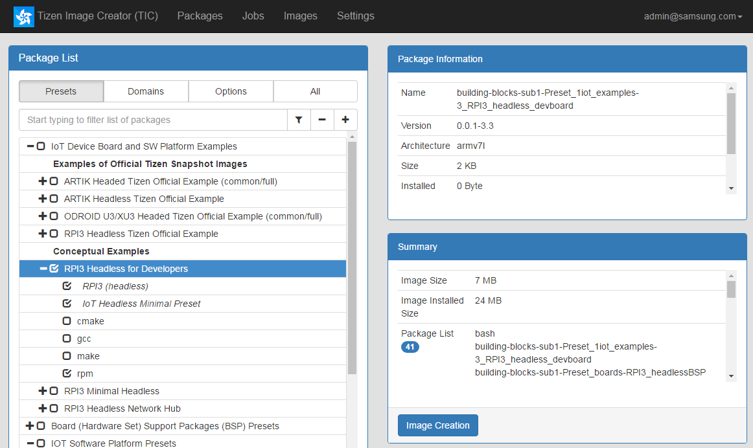
Tizen Image Creator (Visit Demo Booth!)
For Beginners with RPI3,
1. Choose an Example Preset with RPI3
“RPI3 Headless for Developers”

Slide 25
Tizen Image Creator (Visit Demo Booth!)
For Beginners with RPI3,
1. Choose an Example Preset with RPI3
“RPI3 Headless for Developers”
2. Click “Image Creation”

Slide 26
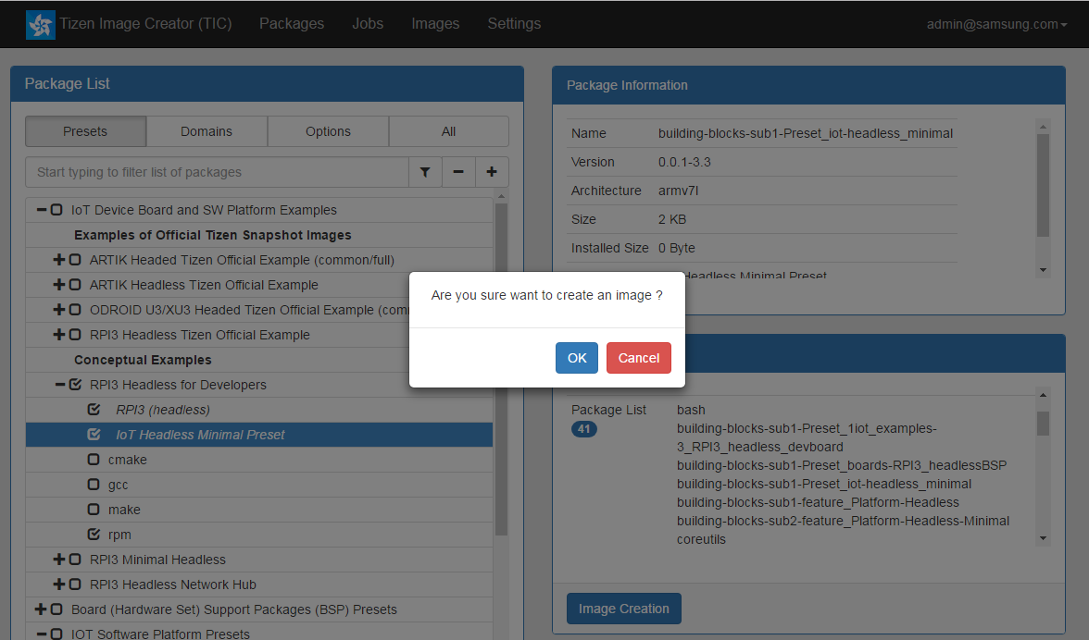
Tizen Image Creator (Visit Demo Booth!)
For Beginners with RPI3,
1. Choose an Example Preset with RPI3
“RPI3 Headless for Developers”
2. Click “Image Creation” then, click “OK”

Slide 27
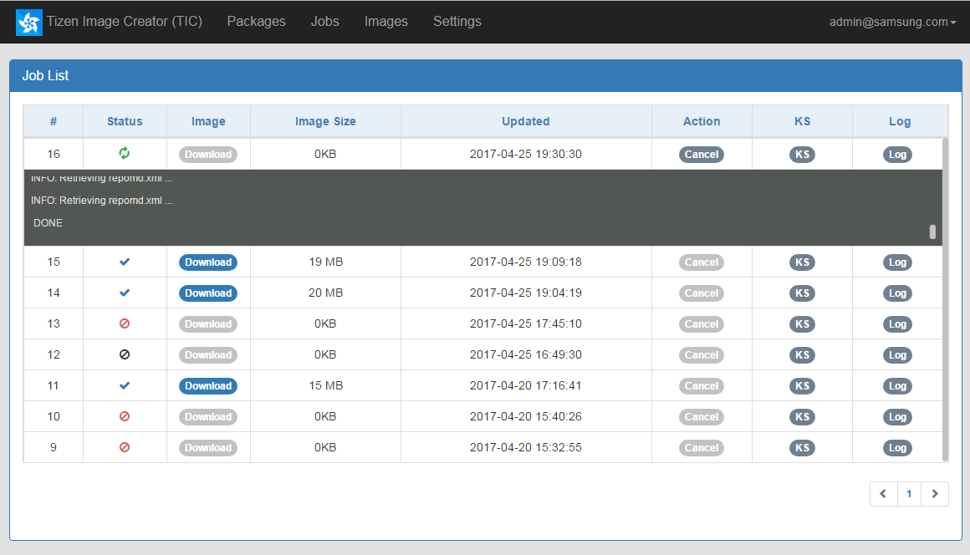
Tizen Image Creator (Visit Demo Booth!)
For Beginners with RPI3,
1. Choose an Example Preset with RPI3
“RPI3 Headless for Developers”
2. Click “Image Creation” then, click “OK”
3. TIC starts to create the Image

Slide 28
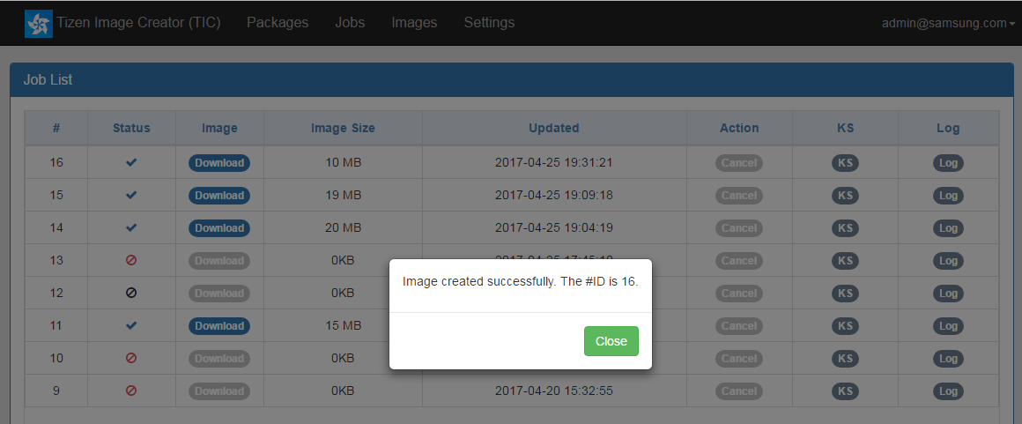
Tizen Image Creator (Visit Demo Booth!)
For Beginners with RPI3,
1. Choose an Example Preset with RPI3
“RPI3 Headless for Developers”
2. Click “Image Creation” then, click “OK”
3. TIC starts to create the Image
then, TIC completes.

Slide 29
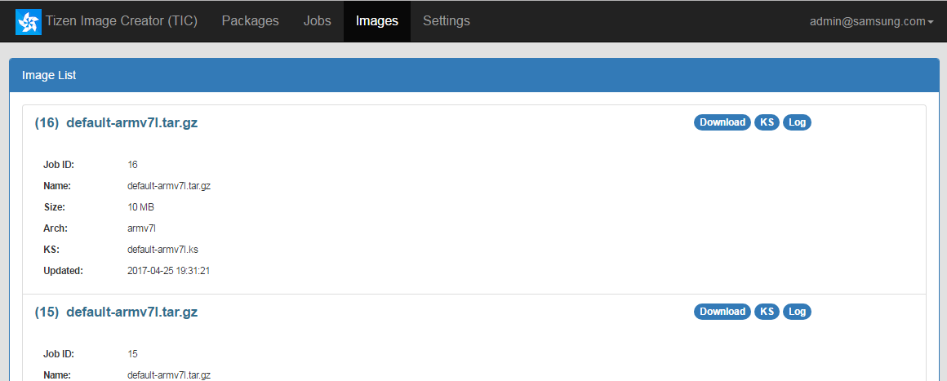
Tizen Image Creator (Visit Demo Booth!)
For Beginners with RPI3,
1. Choose an Example Preset with RPI3
“RPI3 Headless for Developers”
2. Click “Image Creation” then, click “OK”
3. TIC starts to create the Image
then, TIC completes.
4. [Images] shows the list of created images

Slide 30
Tizen Image Creator (Visit Demo Booth!)
Choose individual
features?
blocks?
API sets?
packages?

Slide 31
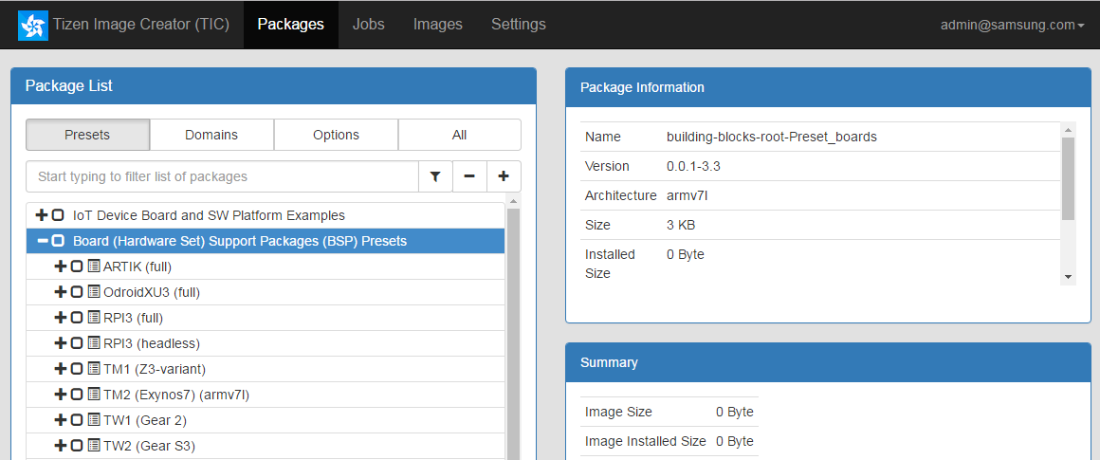
Tizen Image Creator (Visit Demo Booth!)
You may choose
HW boards
You may add drivers to support your own boards.

Slide 32
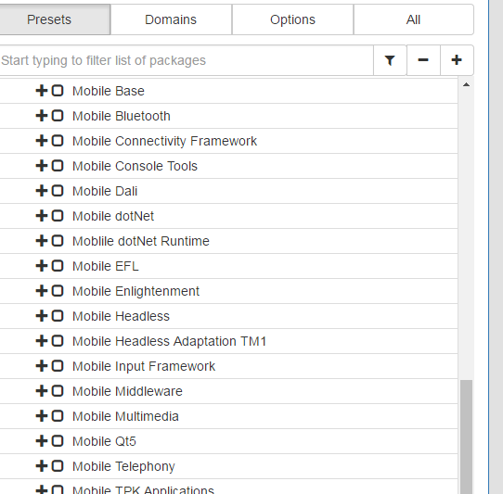
Tizen Image Creator (Visit Demo Booth!)
You may choose
Feature blocks

Slide 33
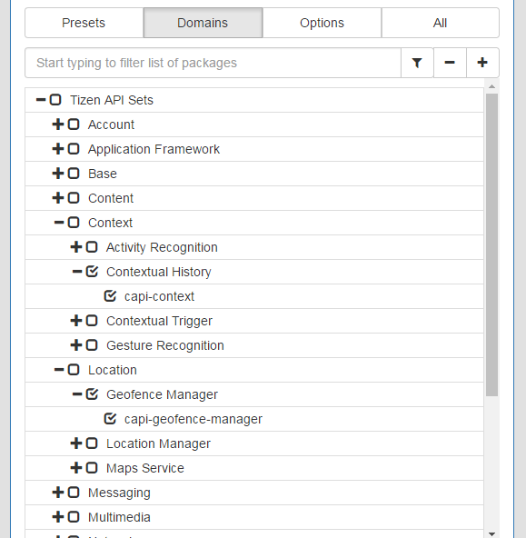
Tizen Image Creator (Visit Demo Booth!)
You may choose
Tizen APIs to support

Slide 34
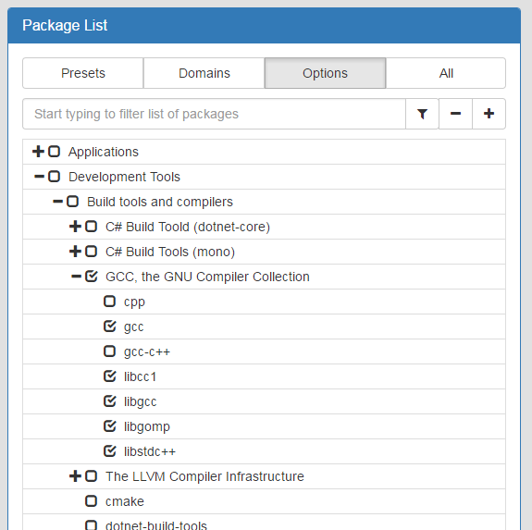
Tizen Image Creator (Visit Demo Booth!)
You may choose
More Options,
Developmental tools, …

Slide 35
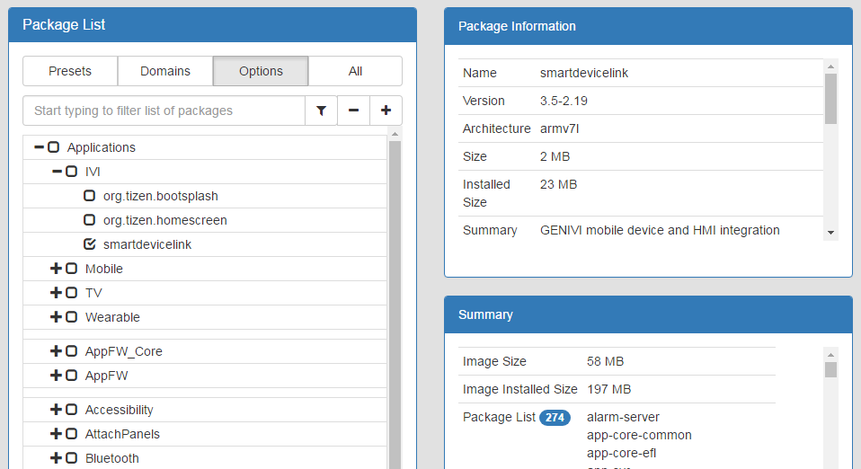
Tizen Image Creator (Visit Demo Booth!)
You may choose
An application (and all it needs at once)
Allows to configure with abstract “blocks”
E.g., Choose “BSP for RPI3” to support Raspberry Pi 3 boards.

Slide 36
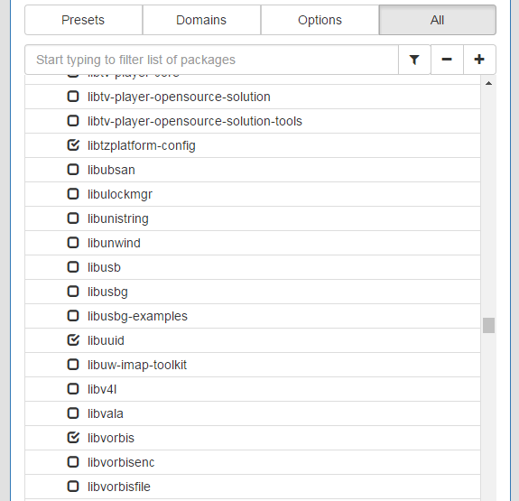
Tizen Image Creator (Visit Demo Booth!)
You may choose
Individual packages

Slide 37
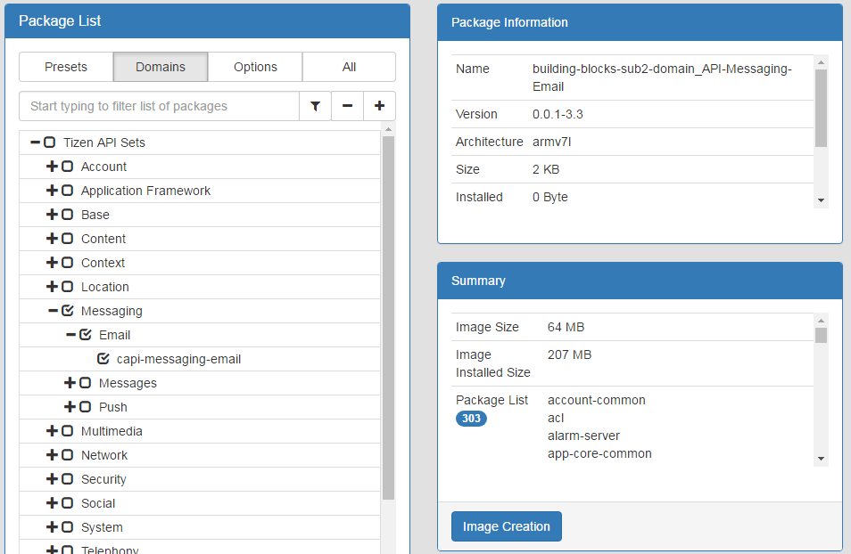
Tizen Image Creator (Visit Demo Booth!)

Slide 38
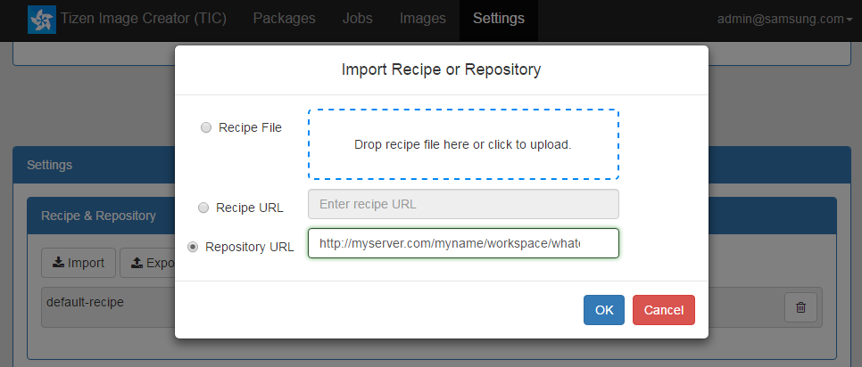
Tizen Image Creator (Visit Demo Booth!)
You may add your own packages

Slide 39
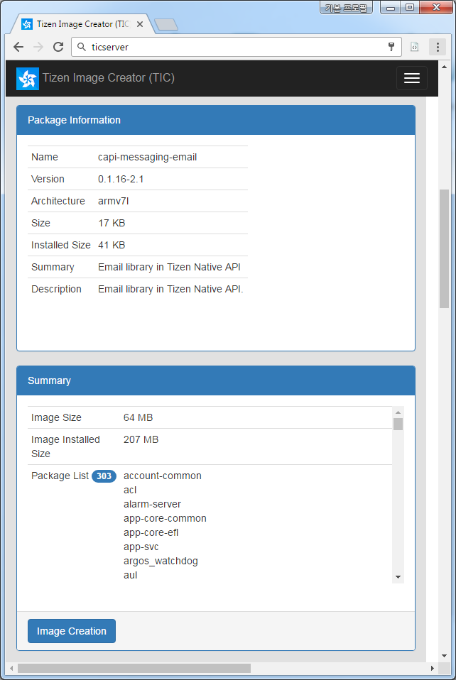
Tizen Image Creator (Visit Demo Booth!)
About your image
About your package

Slide 40
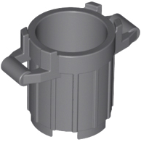
Side Effects
I want Tizen-TV.
Full build at my own infrastructure.
Tizen:TV
700 RPM packages
Download 968 git repos
2,500 RPM packages
1,800 RPM packages
Trash can image from bricklink.com (92926)

Slide 41
Side Effects: Already Solved
Package List Optimizer
To be provided via download.tizen.org soon
Tizen:TV
700 RPM packages
Download 423 git repos (of 968 total)
1,242 RPM packages
These are packages not included in the image, but required by others to build. (and by-product packages)
542 RPM packages
Trash can image from bricklink.com (92926)

Slide 42
Conclusion

Slide 43
Future Work
Open TIC Service
Integration with other Tizen tools (Craftroom)
TIC is still a prototype.
More applications
TIC recipe creation from a Tizen device.
On-the-fly modification of installed Tizen image.

Slide 44
Future Work
Tizen Building Blocks
Add / Refine Block Definitions (UI elements for TIC)
More Examples / Standard Presets
Easier block customization at clients / peers
TIC Performance
TIC Features
SAVE/LOAD!
Easier Locally-built RPM Import
Architecture support. (other than armv7l)
More & Better Filters
Handling linked blocks from another block.
Provide “radio-button” UI. / Allow global extension/profile-selection
Allow to “deselect” required packages of a block
…

Slide 45
Summary
Tizen is Unified
No build projects or build options for profiles.
Only ONE package repositories for ALL PROFILES
Tizen is Configurable
Create your own Tizen OS images by choosing packages from the “Unified Tizen repository”.
“Mix and match” might be required.
Use TIC to easily configure and create your own OS.

Slide 46
APPENDIX

Slide 47
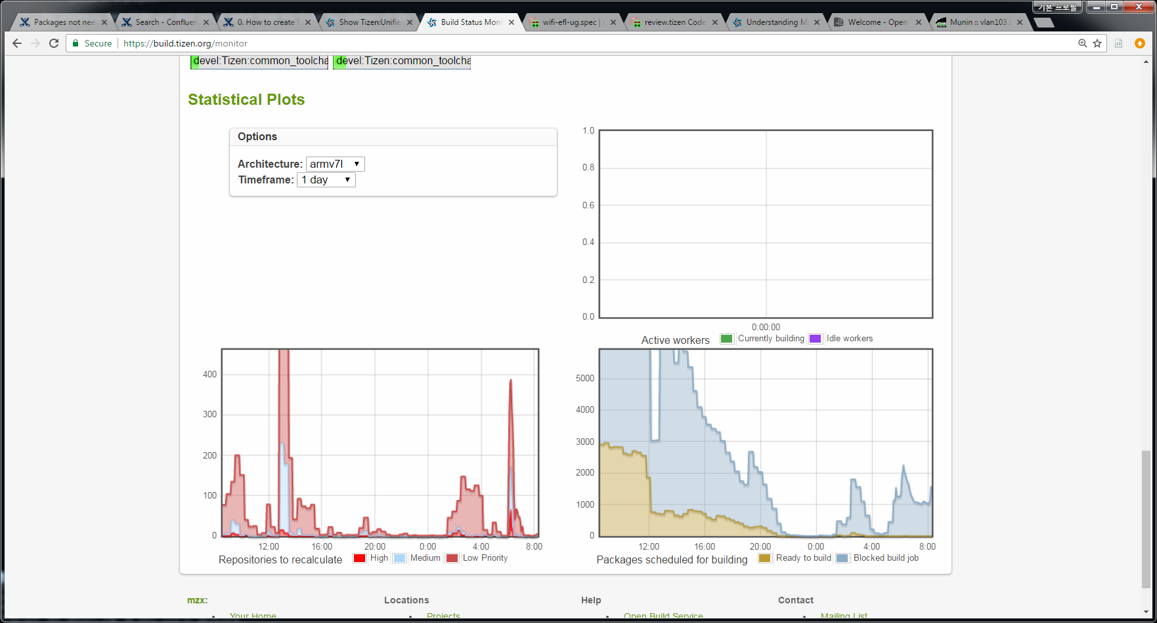

Slide 48
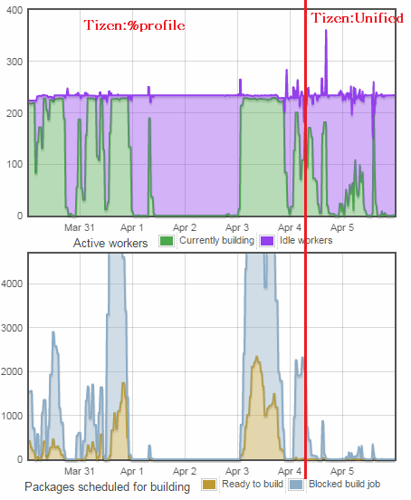
WEEKEND
Server Resource Availability
Task Queue Waiting Khaki: “ready” waiting
Blue: “blocked” waiting

Slide 49
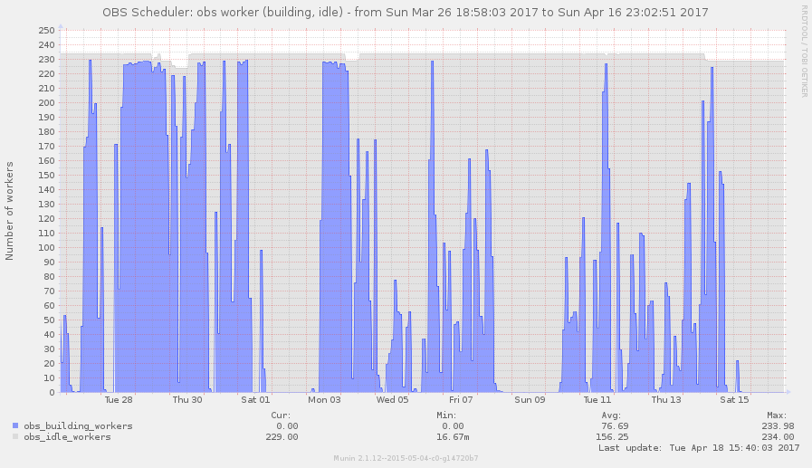
mon.tizen.org/munin/
https://mon.tizen.org/munin/static/dynazoom.html?plugin_name=vlan103.tizen.org%2Fbackend.vlan103.tizen.org%2Fobs_worker_state&start_iso8601=2017-03-26T18%3A58%3A03%2B0900&stop_iso8601=2017-04-16T23%3A02%3A51%2B0900&start_epoch=1490522283&stop_epoch=1492351371&lower_limit=&upper_limit=&size_x=800&size_y=400&cgiurl_graph=%2Fsrv%2Fmunin-cgi%2Fmunin-cgi-graph
Before
After

Slide 50
References
Most icons and images from samsung.com
Lego trash bin image from bricklink.com (92926)
Lego dump image from
https://thehobbyheaven.wordpress.com/2013/08/02/starting-the-lego-adventure/
Memes from
http://knowyourmeme.com/memes/yao-ming-face-bitch-please
https://imgflip.com/memegenerator/Jackie-Chan-WTF

